Slide 1
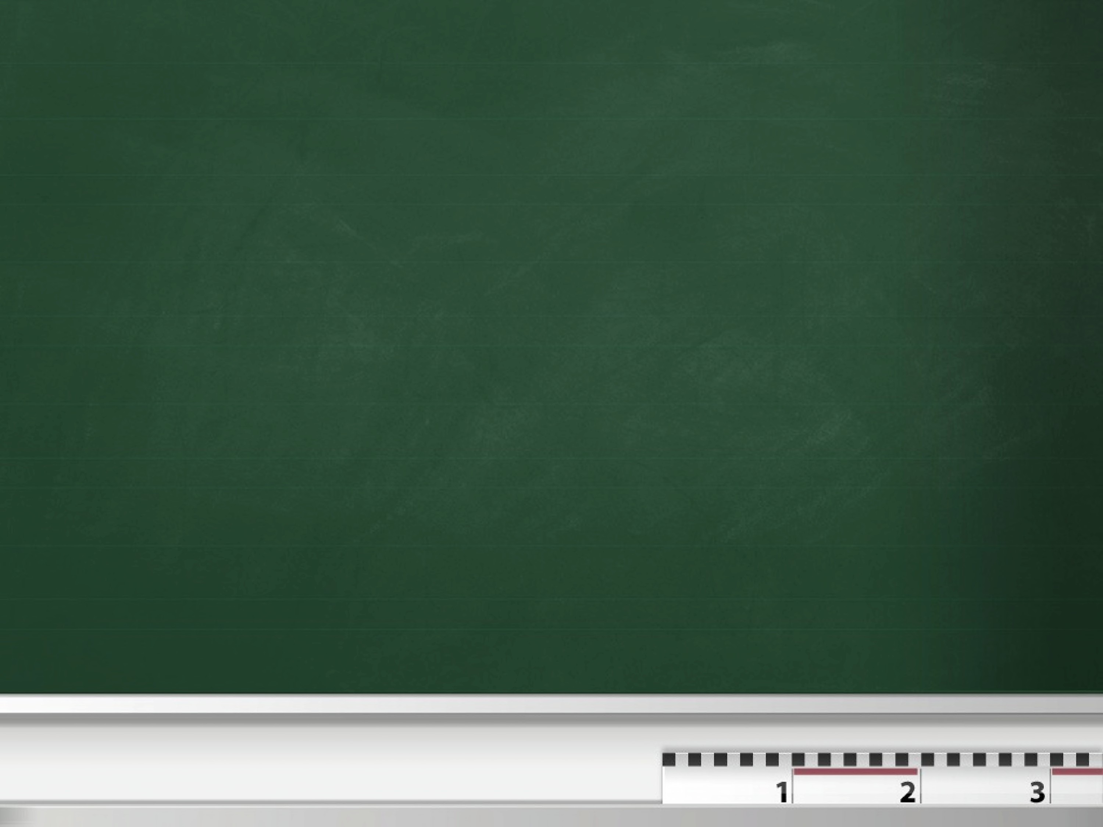
KELOMPOK 5:
1.Abi Andrea N.
2.Hemansyah
3.Rijal Alrosyid
4.Rizaky Okta R.

Slide 2

PRESENT PERFECT TENSE
nm nm n nm nm n nm nm n
1
2
3

Slide 3
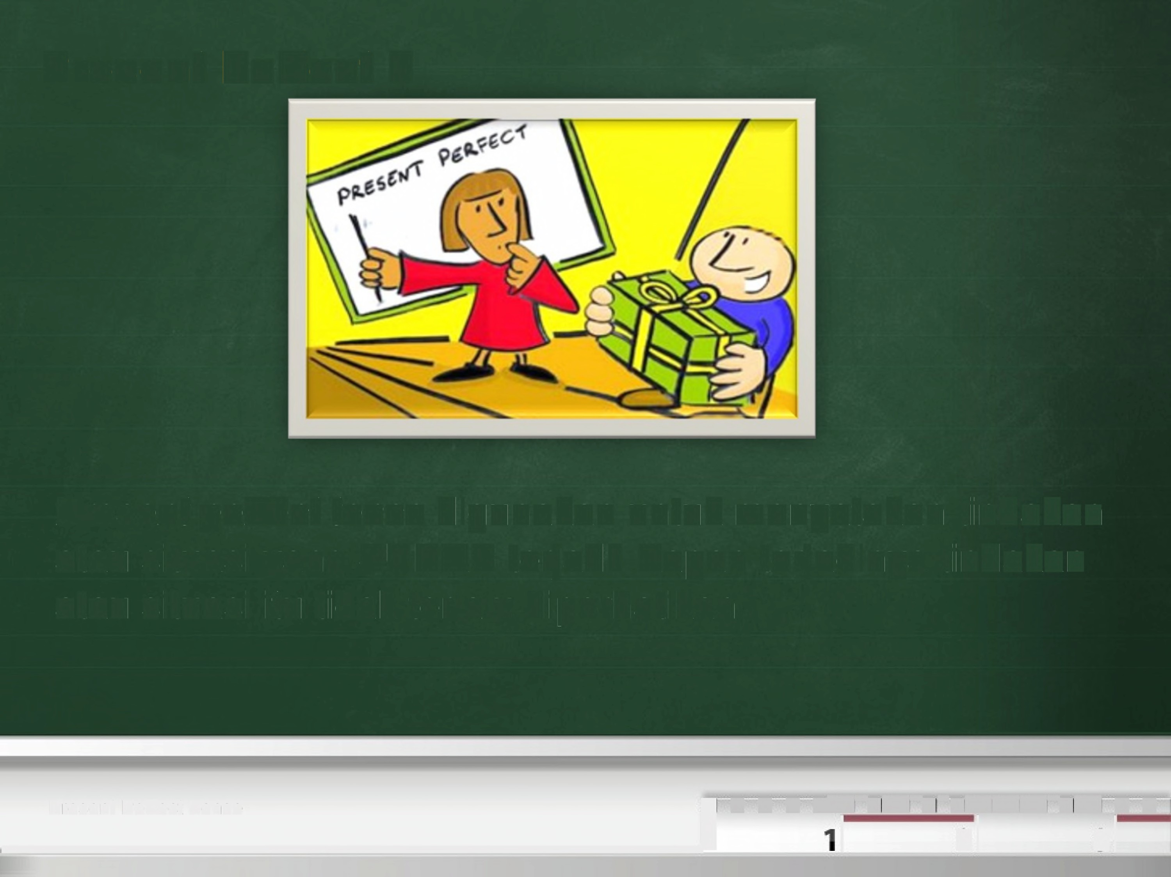
Present
Perfect?
Present perfect tense
digunakan untuk menyatakan tindakan
atau situasi
atau situasi
yang SUDAH terjadi. Kapan
itu tidak terlalu diperhatikan.
terjadinya tindakan
■ ■ -~=■~-■~-~~~-■~ ■ ■
Present Perfect Tense
i
■
s]
el
]
} ,

Slide 4
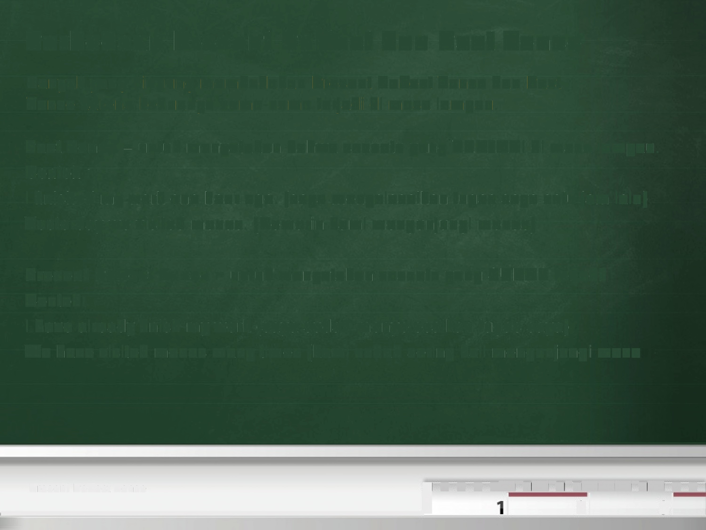
Perbedaan Present Perfect dan Past Tense
Banyak yang bingung membedakan Present Perfect Tense dan Past
Tense karena keduanya sama-sama terjadi di masa lampau.
Past Tense = untuk menyatakan bahwa sesuatu yang TERJADI di masa lampau.
Contoh:
I finished my work one hour ago. (saya menyelesaikan tugas saya satu jam lalu) Yesterday we visited monas. (Kemarin kami mengunjungi monas)
Present Perfect Tense = untuk menyatakan sesuatu yang SUDAH terjadi.
Contoh:
I have already finish my work (saya sudah menyelesaikan tugas saya)
We have visited monas many times (kami sudah sering kali mengunjungi monas)
■ ■ ■ -~=■~-■~-~~~-■~ ■ ■
Present Perfect Tense
i
el]
},
s]

Slide 5
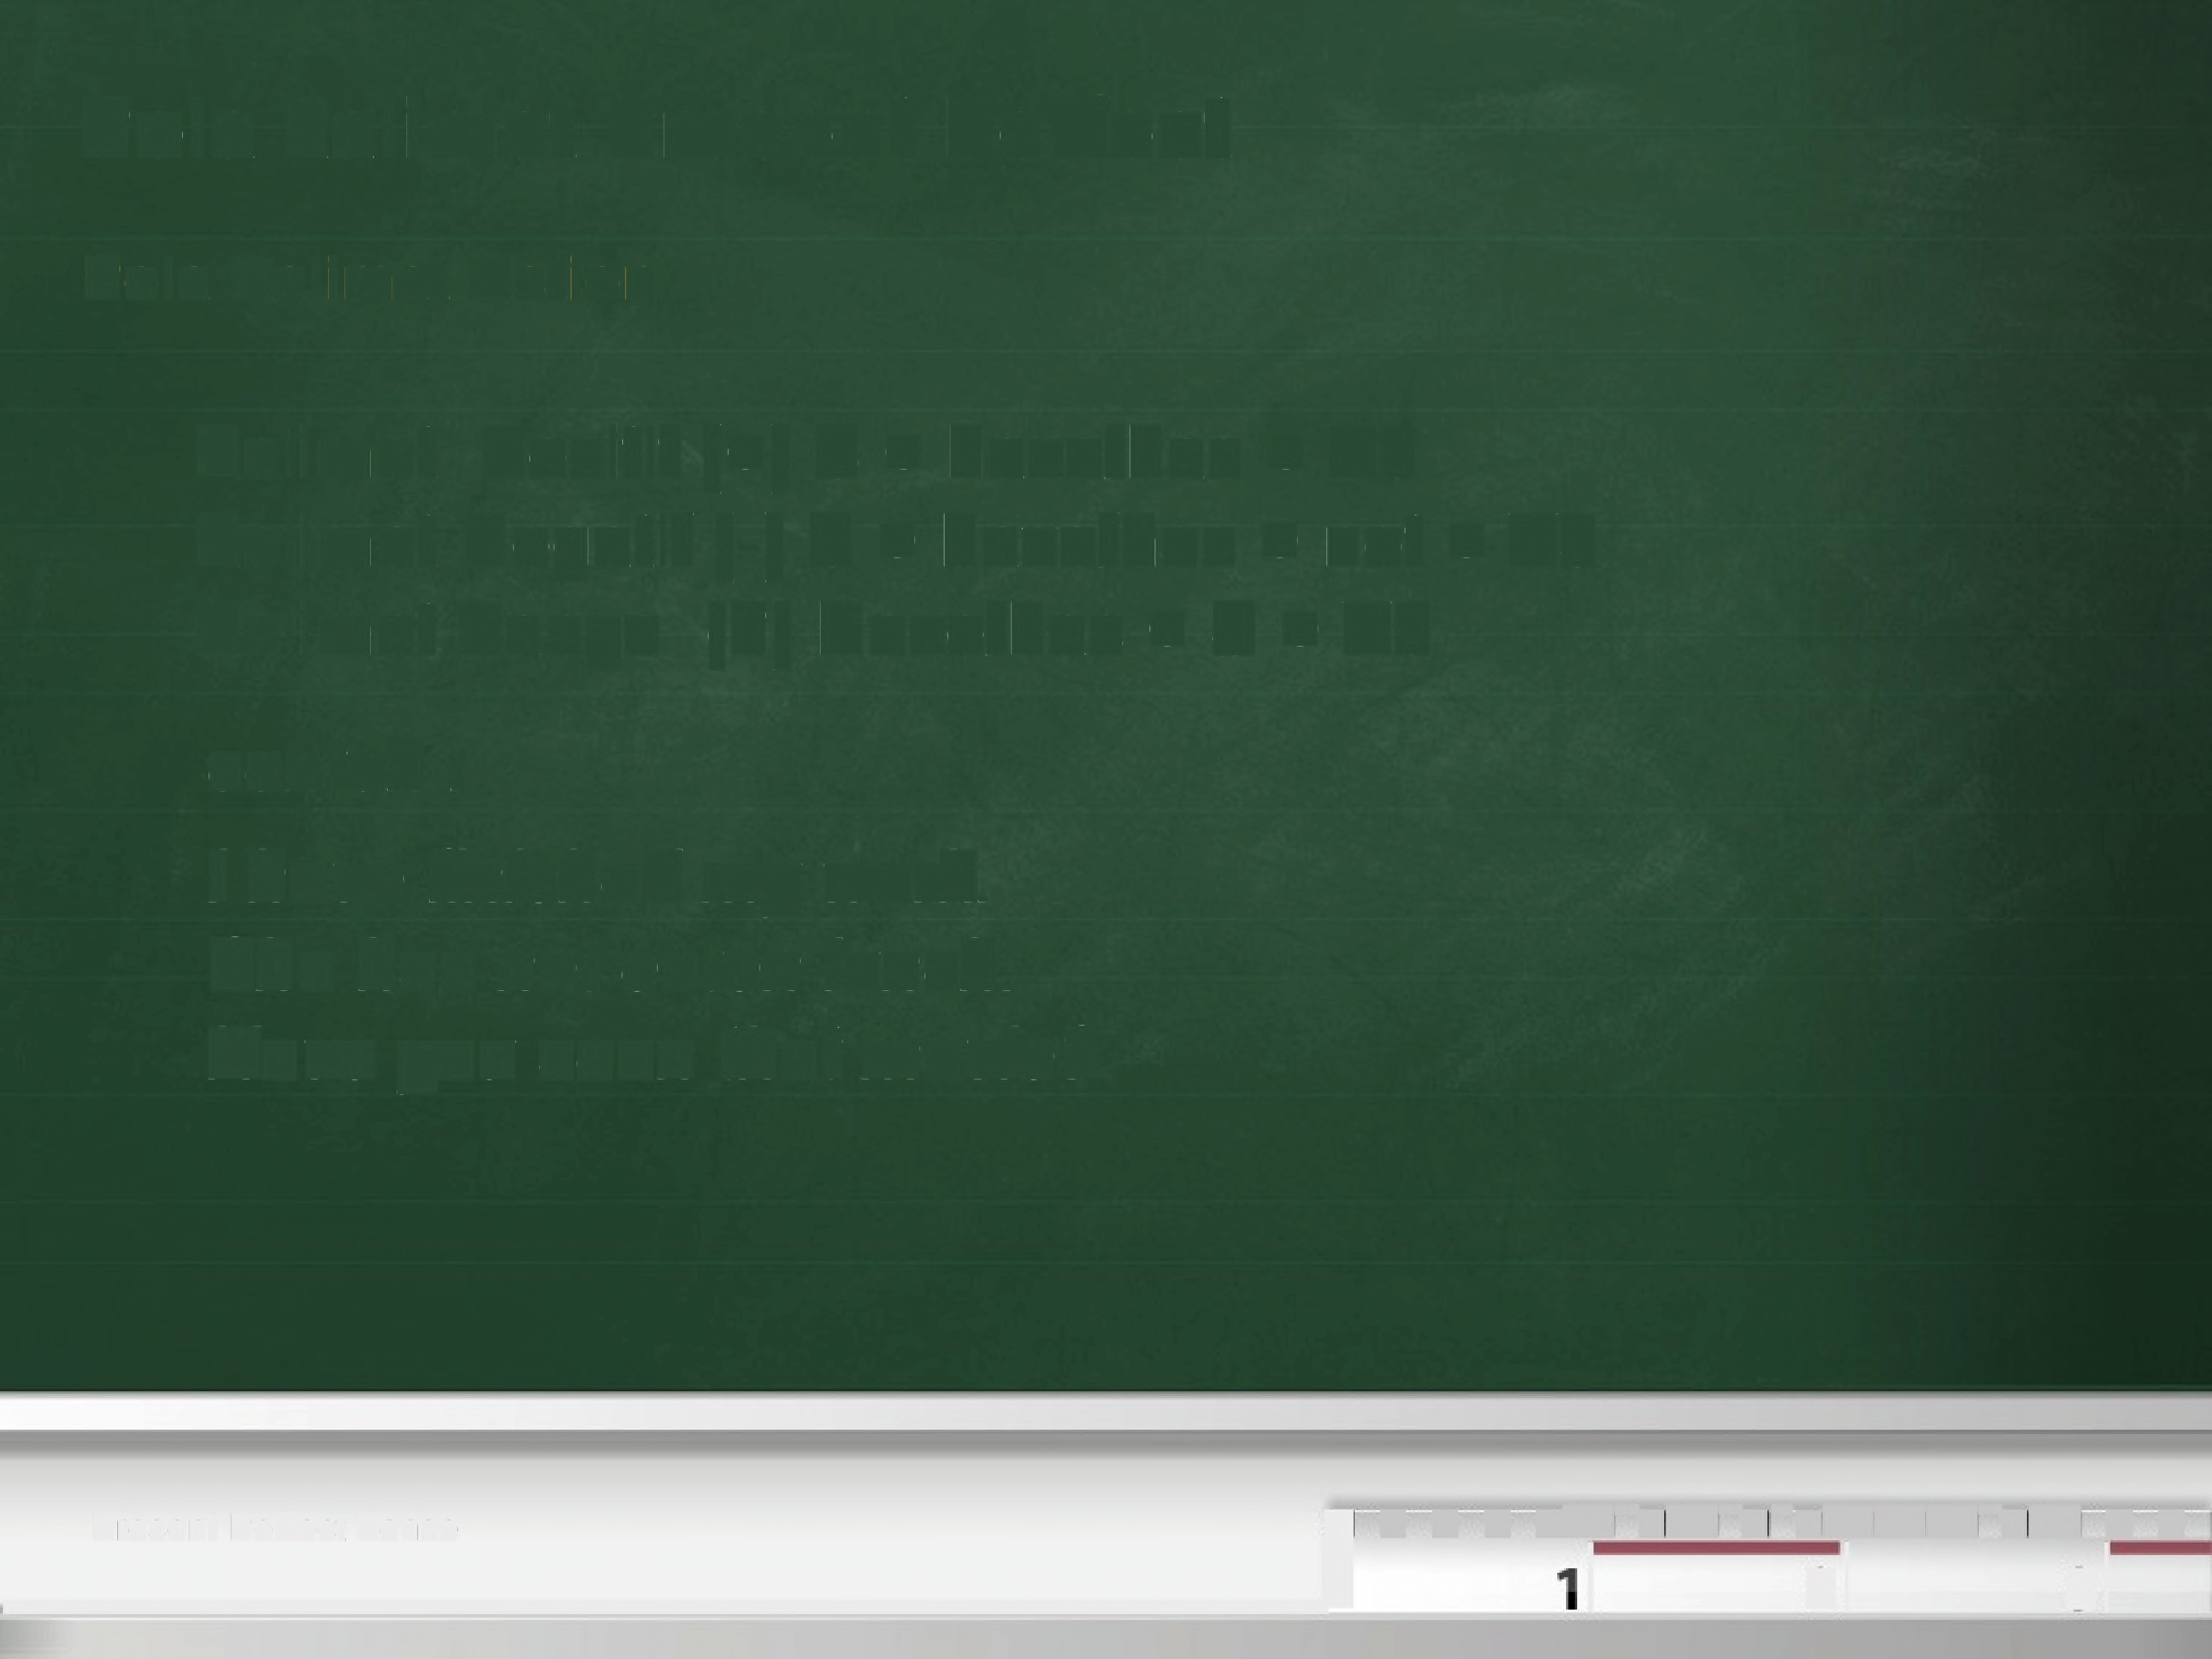
Pola kalimat Present Perfect
Pola Kalimat Action
Kali mat
Kalimat
Kalimat
Positif ( +)
Negatif (-) Tanya (?)
S + have/has + V3
S +have/has+ not+
V3
Have/has
+
S
+
V3
contoh:
I have finished my
She has not eaten
work.
lunch.
Have you seen that movie?
■ ■ ■ -~=■~-■~-~~~-■~ ■ ■
Present Perfect Tense
i
el]
},
s]

Slide 6
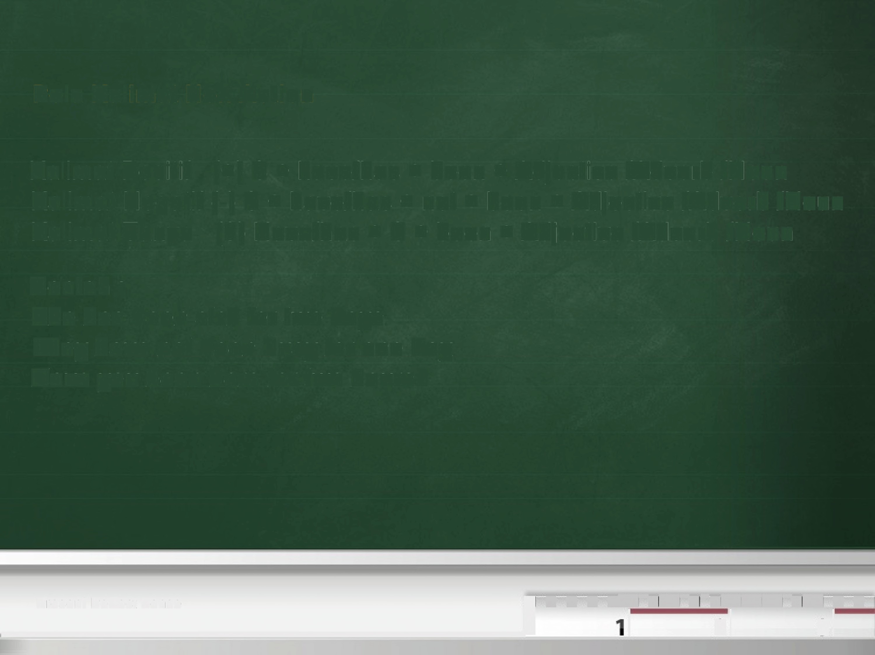
Pola Kalimat Non Action
Kalimat
Kalimat
Kalimat
Positif
Negatif
Tanya
(+) S +have/has+ been+ Adjective /Adverb /Noun
(-) S +have/has+ not+ been+ Adjective /Adverb /Noun
(?) Have/has + S + been
+Adjective/Adverb
/Noun
Contoh
:
She has been sick for two days.
They have not been busy for one day.
Have
you
been
here
for
two
hours?
■ ■ ■ -~=■~-■~-~~~-■~ ■
Present Perfect Tense
i
■
el]
},
s]

Slide 7
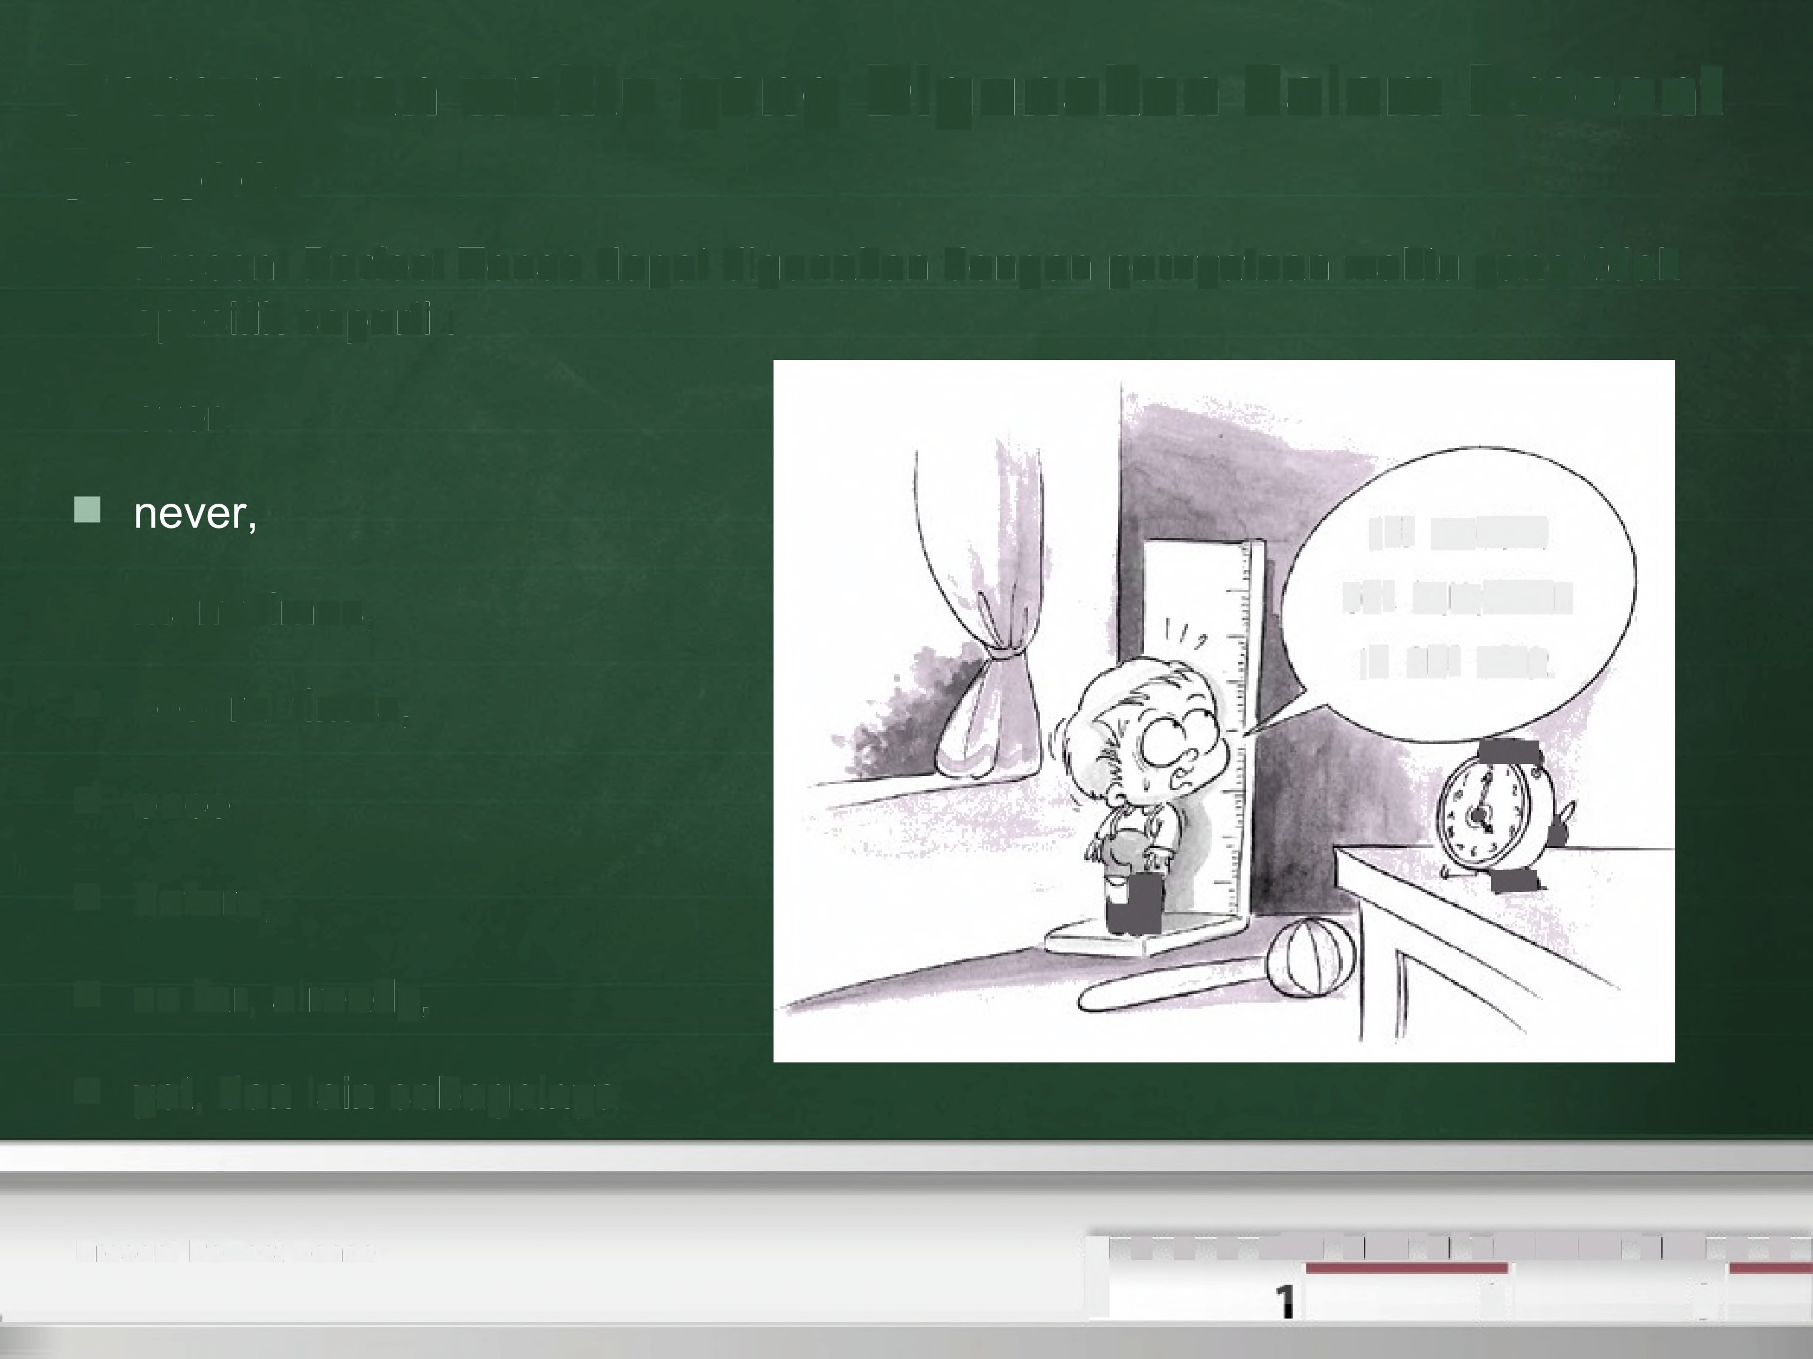
Pernyataan waktu yang Digunakan dalam Present
Perfect
Present Perfect Tense
dapat
digunakan
dengan
pernyataan
waktu yang tidak
spesifik seperti
:
■
ever,
'VE GROWN
ONE WLLIMETER
■
■
■
■
■
■
many times,
IN
ONE YEAR.
several times,
~
...
p
once,
~,
l
'»
before,
so far, already,
yet, dan lain sebagainya
■ -~=■~-■~-~~~-■~ ■ ■
Present Perfect Tense
i
■ ■
el]
},
s]

Slide 8
SOAL
Match The Sentences On Both Columns To Make Good Sentences
Column A | Column B
1. The rain has stopped, … (c) | a. And I have returned it into Bella.
2. The mechanic has repaired the pump, … (e) | b. And the meeting will begin soon.
3. I have finished reading the novel, … (a) | c. And I can continue my trip.
4. Adi has turn on the TV, … (d) | d. And we can enjoy the live match.
5. All participants have gone in to the room, … (b) | e. And the water is flowing again.

Slide 9
PATTERN JAWABAN
1. S + has + V3 + and + S + can + V1 + Complement
2. S + has + V3 + O + and + S + to be + V1(-ing) + Adv
3. S + have + V3 + Complement + and + S + have + V3 +
Complement
4. S + has + V3 + O + and + S + can + V1 +
Complement
5. S + have + V3 + Adv + and + S + will + V1 +
Complement

Slide 10
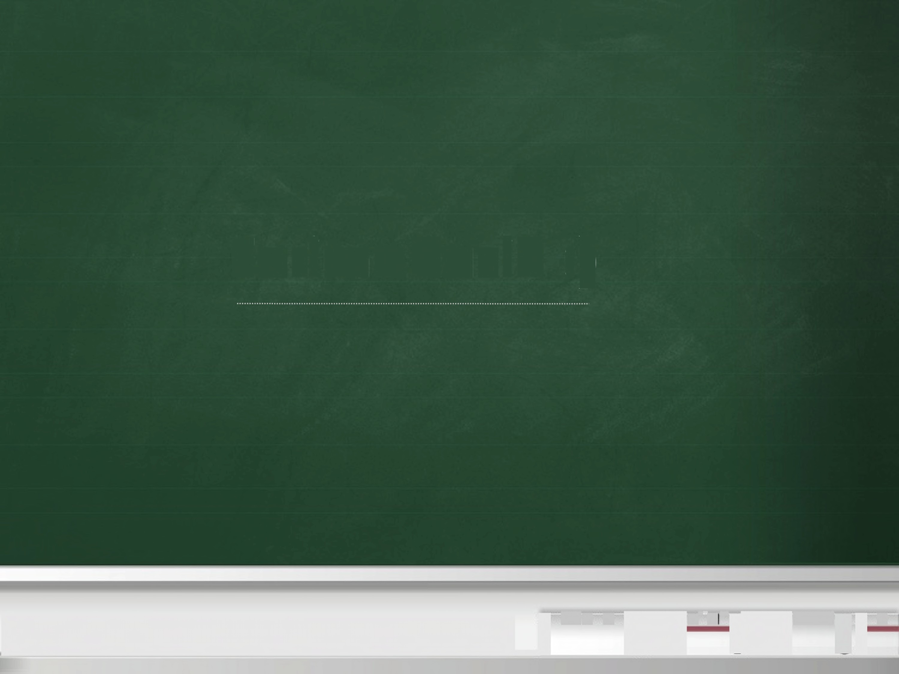
Terimakasih
☺
■ r---■~~,~; i ■
""" .j
--■

